Slide 1

Data-Driven Personalization in Fintech: Insights and Solutions
Name: Eniola Taiwo Date: November 2024

Slide 2
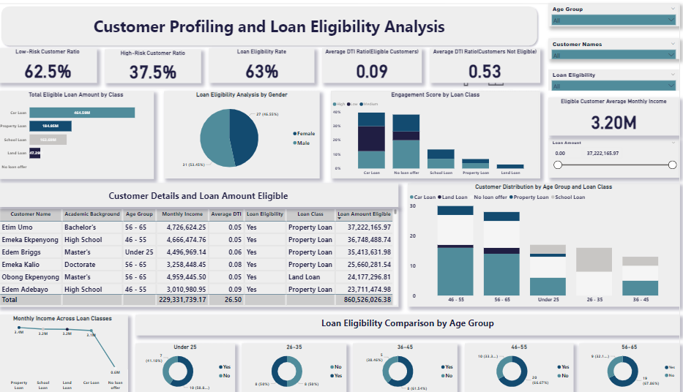
Customer Profiling and Loan Eligibility Analysis
Name: Eniola Taiwo Date: November 2024

Slide 3
Overview
Objective:
To assess customer profiles and determine loan eligibility across various loan classes, using insights from DTI, income levels, engagement scores, and demographics.
Core Findings:
Risk and Eligibility Profiles:
62.5% of customers are low-risk, qualifying more easily for loans due to favourable DTI and income factors.
DTI Ratio: A key factor, with customers below a 0.35 DTI ratio showing higher eligibility, especially for premium loan types.
Income-Based Loan Suitability:
Average monthly income plays a crucial role, with high-income customers qualifying for larger loans such as property and car loans.
Engagement Scores and Loan Classes:
Engagement scores influence loan types: high engagement aligns with premium loans (e.g., car loans), whereas lower engagement is seen with smaller loan products like school loans.
Demographic Patterns:
Eligibility peaks among customers aged 56-65, largely due to income stability, while younger customers qualify more for school and land loans.
Purpose:
This analysis supports targeted loan marketing and tailored product offerings, helping align loan classes with customer profiles for more effective engagement and growth strategies.

Slide 4
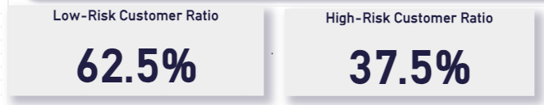

Customer Risk Profile
Insight: 62.5% of customers are classified as low-risk, indicating a substantial portion of customers have a stable financial profile. Meanwhile, 37.5% are high-risk, which suggests potential areas for improving customer support or screening.
Prescription: Introduce targeted financial education or support programs for high-risk customers to help them reduce financial stress and improve creditworthiness. Additionally, refine risk assessment criteria to more accurately predict high-risk profiles, potentially using engagement scores or other behavioural metrics as early indicators of risk.
62.5% Low-Risk Customers: Indicates a majority of customers are relatively low risk.
37.5% High-Risk Customers: Suggests areas for improved screening or targeted support for higher-risk customers.

Slide 5
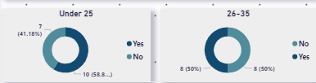

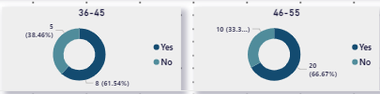
Loan Eligibility by Age Group
26-35: 50% eligibility, indicating this age group is building eligibility, potentially affected by early career income constraints.
36-45: 62% eligibility, the highest among all age groups, aligning with peak earning years.
46-55: High eligibility, although data shows a slight decrease in loan need.
56-65: 67% eligibility rate, likely reflecting higher income and asset stability, making them attractive loan candidates.
Under 25: 59% eligibility rate, reflecting the growing financial independence and creditworthiness of younger customers.
Young Adults (Under 25): Develop flexible school loan packages, perhaps with deferred payment options, to cater to younger customers building careers. Additionally, offer early credit-building products to increase their eligibility for future loans.
Early Career (26-35): Consider short-term car loan packages or professional development loans to meet evolving needs as they stabilize income and career progression.
Peak Earning Age (36-45): Offer larger-scale loans like property and car loans with favourable terms, as this group has the highest eligibility and income levels.
Mature Customers (46-65): Introduce retirement-focused loans, such as land and property loans, which appeal to older customers looking for investment or retirement planning options.

Slide 6
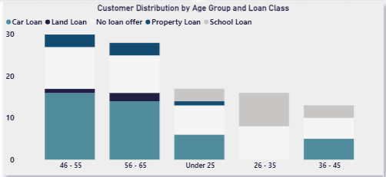
Customer Distribution by Age and Loan Class:
Car Loans: Popular among various age groups, especially those aged 36-45 and 46-55, indicating strong demand for personal vehicle financing.
School Loans: Predominantly requested by younger age groups (23-35), reflecting career-focused or skill-building educational goals.
Property Loans: Higher demand among the older age groups (46-55), indicating an interest in long-term investment and asset acquisition as customers approach retirement.
Land Loans: Generally lower in demand but more frequent among the 46-55 age group, potentially for retirement or asset diversification purposes.
Car Loans: Continue promoting to 36-45 and 46-55 age groups. Enhance loan packages with incentives for eco-friendly vehicles or family car options, which may increase demand in these segments.
School Loans: Increase promotions for school loans among young adults (under 25 and 26-35). Partnering with educational institutions for financing options could enhance visibility.
Property Loans: Market property loans as an investment opportunity for higher-income, older customers. Offer wealth management advice and retirement planning options to complement these loans
.
Land Loans: To increase uptake, consider promotional interest rates or flexible tenures targeting 46-55 age groups interested in investment diversification.

Slide 7
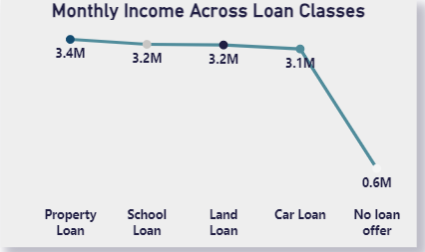
Monthly Income Across Loan Class:
To meet the needs of high-income customers, consider introducing premium property loan options with additional perks, such as priority processing, flexible repayment terms, and potential tax advisory support.
Offer co-branded school loans with educational institutions, allowing high-income clients to access exclusive scholarships or tuition discounts for dependents, making education financing more appealing to this group.
Car loans can be marketed with flexible down payment options, which could appeal to upper-middle-income customers who may want easier access to financing for personal or family vehicles.
Consider offering incentives for eco-friendly or luxury car financing options to attract higher-income customers interested in sustainability or premium vehicle brands.
Market land loans as investment vehicles for high-income customers, with incentives such as favourable interest rates or longer repayment terms to attract those interested in real estate as a long-term asset.
To potentially reach low-income customers with no current loan offers, explore small loan products or microfinance options that support basic needs, which can create a pathway for future loan eligibility as their financial situation improves.
Flexible Loan Structures: Customize loan terms for each class, adjusting for income brackets to better align with financial capacity and encourage uptake of various loan products.
Segmented Marketing Strategies: Tailor marketing messages to specific income groups, promoting premium products to high-income earners and affordable options to middle-income earners to maximize reach.
Cross-Sell Potential: For high-income customers with one type of loan (e.g., property), offer complementary products like school or land loans to diversify engagement and build brand loyalty.
Financial Inclusion Initiatives: Introduce educational programs and small-scale loans for lower-income customers with no loan offers, creating pathways for improved financial literacy and future loan eligibility.

Slide 8
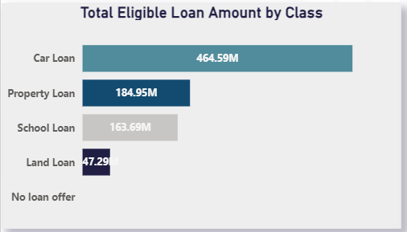
Total Eligible Amount by Class
Given its high demand, car loan disbursements are expected to be a significant portion of overall loan distribution. This will require careful planning for cash flow and the alignment of the company's lending capacity.
Customer Profile: Likely to be individuals with medium-to-high incomes, looking for personal or business vehicles.
These loans are likely to be larger in value and longer in tenor, which means the company should ensure liquidity for long-term repayment schedules. Property loans also require more stringent credit checks due to their size and the collateral involved.
Customer Profile: Homebuyers, real estate investors, or individuals seeking to secure property for residential or business purposes.
Although demand is lower, it’s important to monitor land loan eligibility closely, as this could shift based on changing economic conditions or investment trends. Offering incentives for land development could boost interest.
Customer Profile: Investors in land or individuals seeking to secure undeveloped property for future projects.
School loans are typically smaller in amount but can be frequent and require a structured disbursement plan. The company should consider offering flexible repayment terms, particularly for younger customers or students in lower income brackets.
Customer Profile: Parents, young adults, or students looking to finance higher education, professional certifications, or skills development.
Car loans: represents the highest demand among the loan types, highlighting customers' strong desire to invest in vehicles. This could be driven by personal transportation needs or business-related purchases. Property loans: though second in demand, still account for a significant share of the loan portfolio. These loans are typically long-term and may reflect customers' interest in securing real estate for personal or investment purposes. Education loans: highlight strong demand for funding academic pursuits. This is especially relevant to younger customers investing in their futures, or parents seeking to fund their children's education..
Land loans: represent the lowest demand among the loan classes. This may be due to income constraints or the lower perceived value of land as an investment compared to property or vehicles.

Slide 9
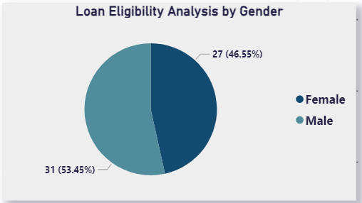
Gender-Based Loan Eligibility:
For Male Customers: Consider offering a range of investment-based loans, such as property or business loans, which align with their higher eligibility. Tailored financial literacy programs and consultations could also enhance uptake, particularly among high-income males.
For Female Customers: Focus on loan products that support career advancement or lifestyle goals, such as education or small business loans, and offer flexible terms to improve accessibility and eligibility.
Male Customers: 53% are eligible for loans, showing slightly higher eligibility than females. This could suggest higher average income or a greater likelihood to meet loan criteria.
Female Customers: 47% eligibility, indicating strong but slightly lower loan eligibility rates compared to males.

Slide 10
Summary & Recommendations
Summary: Risk Distribution and Eligibility:
Our customer base shows a 62.5% low-risk and 37.5% high-risk profile. Low-risk customers, especially those with a DTI below 0.35, are more likely to qualify for higher-value loans, confirming DTI as a critical eligibility indicator.
Income-Driven Eligibility for Loan Classes:
Customers with average monthly incomes around £2.3M qualify for higher-value loans like property and car loans. Income plays a substantial role in determining loan eligibility, especially for premium loan classes.
Engagement Score Influence:
High engagement scores correlate with eligibility for larger loan amounts, particularly for car loans, while lower engagement scores often align with smaller loans (e.g., school or land loans). Engagement scoring serves as a potential predictor for loan class preference.
Demographics and Loan Distribution:
Age group analysis reveals that customers aged 56-65 have the highest eligibility rate across loan classes, likely due to income stability and low DTI ratios. Gender analysis shows a slightly higher loan eligibility rate for male customers (53%), suggesting potential to explore more inclusive strategies for female customers.
Target marketing efforts for premium loan classes (e.g., property and car loans) to customers with low DTI and high engagement scores, as they show the highest eligibility potential.
Develop tailored loan products for younger segments, focusing on educational and entry-level loans to match their income profiles, and continue to promote premium loans to older, stable-income customers.
Introduce more flexible tenure options for borderline-eligible customers to balance affordability and loan accessibility, especially for medium-income and moderate-risk customers.
Implement financial planning workshops for high DTI customers to help lower their ratios, making them eligible for larger loan amounts and potentially increasing their engagement with the brand.
Optimize Loan Tenure Options:

Slide 11
Thank You

